Slide 1

WEATHER FORECASTING FOR POWER PREDICTION
NEHARIKA K (CB.EN.U4EEE22026)
PRITHIKA S V(CB.EN.U4EEE22032)
VEDAVARSHA N T (CB.EN.U4EEE22154)

Slide 2


CONTEXT
INTRODUCTION | 3
METHODOLOGY | 4
IMPLEMENTATION PROCESS | 5
RESULT AND ANALYSIS | 6
CONCLUSION | 21
FUTURE SCOPE | 22
REFERENCES | 23

Slide 3
INTRODUCTION
Power consumption prediction and classification play a vital role in energy management, enabling organizations and governments to optimize electricity usage, reduce wastage, and improve sustainability. With the rapid growth in electricity demand and the increasing adoption of renewable energy sources, accurate forecasting and classification of power consumption are critical for ensuring a stable and efficient power grid.
Traditional methods of power forecasting relied on statistical models and historical trends, but with the advent of machine learning and artificial intelligence, modern predictive models can capture complex patterns, correlations, and dependencies within large datasets. This project leverages various machine learning algorithms, including ensemble methods like Random Forest and XGBoost, as well as deep learning techniques such as Multi-Layer Perceptron (MLP), to analyze power consumption data and make accurate predictions.

Slide 4
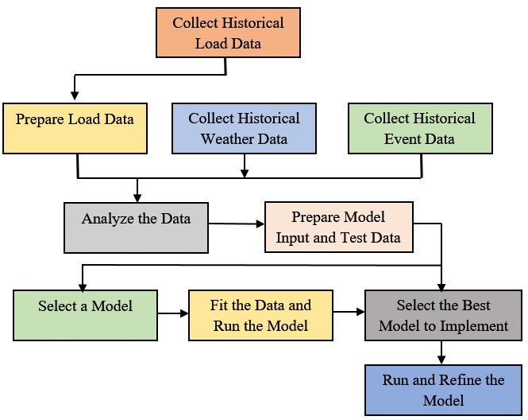
METHODOLOGY:

Slide 5

IMPLEMENTATION PROCESS
A. Power Consumption Prediction:
Implemented Random Forest and XGBoost regressors to predict cumulative power usage using weather data. XGBoost showed higher accuracy in forecasting power consumption trends. Implemented Random Forest Classifier to predict the Power Consumption and evaluate Precision, Recall, Accuracy and Correlation matrics.
B. Power Consumption Classification:
Utilized Gradient Boosting and K-Nearest Neighbors classifiers to categorize power consumption levels. KMeans clustering was applied to create consumption categories. Gradient Boosting achieved higher accuracy in classification.
C. Power Consumption Prediction Using MLP Classifier:
Implemented a Multi-Layer Perceptron (MLP) classifier to predict power consumption levels based on weather data. The target variable was discretized into three classes (Low, Medium, High) using quantile binning. The trained model achieved a good accuracy score, demonstrating effective classification performance.
D. Power Consumption Prediction and Peak Hour Analysis Using Random Forest Regressor:
Implemented a Random Forest Regressor to predict cumulative power consumption based on weather data. Identified peak hours by classifying the top 10% highest power usage and analyzed the power distribution. Also included a renewable energy optimization step for solar power usage efficiency.
E.Power Consumption Prediction Using CNN-Based Deep Learning Model: Implemented a CNN-based deep learning model to predict power consumption using weather data. The model includes Conv1D layers for feature extraction, dropout for regularization, and dense layers for regression. Performance was optimized with learning rate tuning, achieving improved accuracy with MAE, MSE, and R² metrics.
F. Optimized Electricity Pricing for Peak Load Reduction Using Smoothed Predictions:
Developed a pricing optimization strategy using smoothed load predictions to reduce peak electricity demand. A moving average filter was applied to enhance prediction stability, aligning optimized pricing with demand fluctuations. The approach aims to improve grid efficiency and reduce costs.
G. Peak Hour Prediction Using CatBoost Classifier:
Utilizes the CatBoost Classifier to predict peak electricity usage hours based on weather and power consumption data. The model achieves an impressive accuracy of 99.83% demonstrating its effectiveness in distinguishing between peak and non-peak hours.

Slide 6
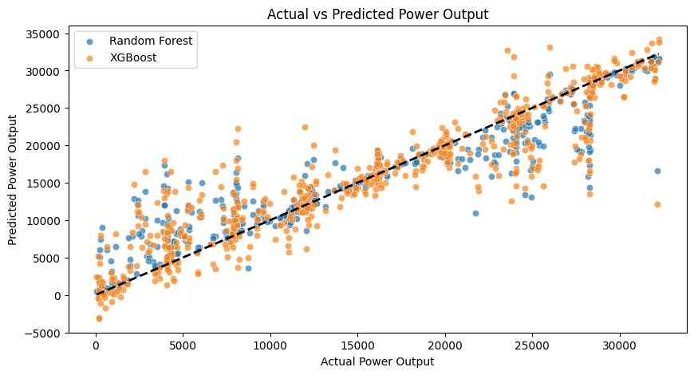
Results and Discussion
The proposed models effectively analyze collision risk, vehicle behavior, and lane adherence, demonstrating strong performance across various machine learning techniques.
A. Power Consumption Prediction Using Random Forest and XGBoost
Random Forest Regressor Performance:
MAE: 1971.7670
MSE: 10,911,322.0237
R² Score: 0.8807
XGBoost Regressor Performance
MAE: 2526.8329
MSE: 14,803,271.1081
R² Score: 0.8382

Slide 7
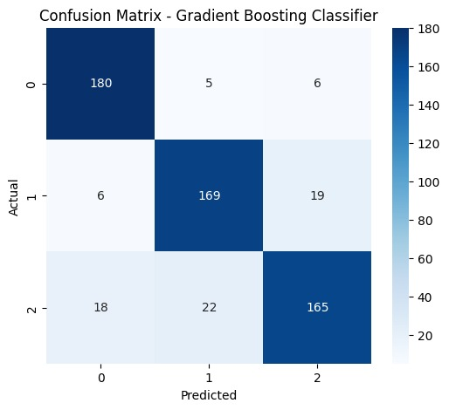
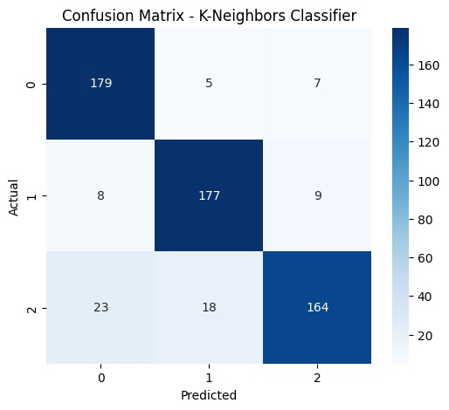
B. Power Consumption Classification Using Gradient Boosting and K-Nearest Neighbors
Gradient Boosting Classifier Performance:
Accuracy: 87.12%
Precision: 87.09%
Recall: 87.12%
F1-Score: 87.03%
K-Neighbors Classifier Performance:
Accuracy: 88.14%
Precision: 88.35%
Recall: 88.14%
F1-Score: 88.05%

Slide 8
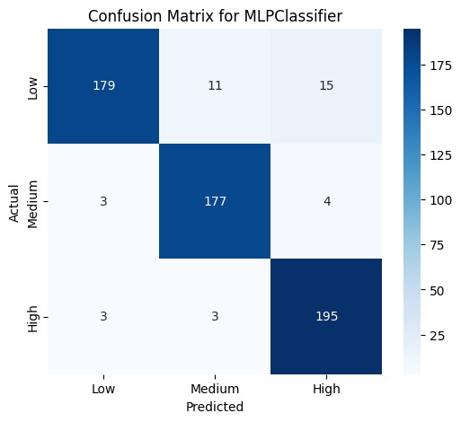
C. Power Consumption Prediction Using Multi-Layer Perceptron (MLP) Classifier
The Power Consumption Prediction Using Multi-Layer Perceptron (MLP) Classifier achieved an accuracy of 93.39%. The dataset included features such as Temperature, Weather, Wind, Humidity, Barometer, cum_power, Elec_kW, and Gas_mxm. The classification report shows high performance across all classes, with Class 0 having a precision of 97% and recall of 87%, Class 1 achieving 93% precision and 96% recall, and Class 2 reaching 91% precision and 97% recall. The macro and weighted averages indicate strong overall model performance, making MLP an effective approach for power consumption classification.

Slide 9
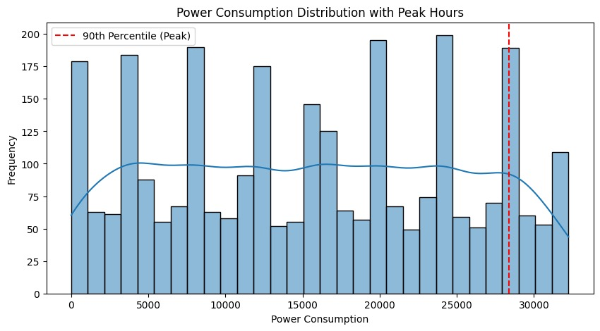
D. Power Consumption Prediction and Peak Hour Analysis Using Random Forest Regressor
MAE: 1971.7670
MSE: 10911322.0237
R² Score: 0.8807

Slide 10
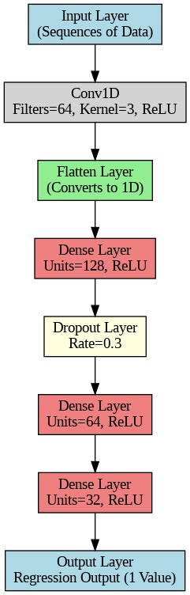
E.Optimized CNN-Based Deep Learning Model for Power Consumption Prediction
MAE: 4.9364
MSE: 41.9432
R² Score: 0.5392

Slide 11
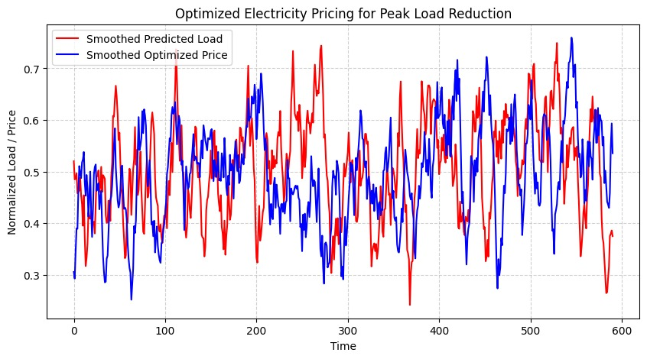
F. Optimized Electricity Pricing for Peak Load Reduction Using Smoothed Predictions

Slide 12
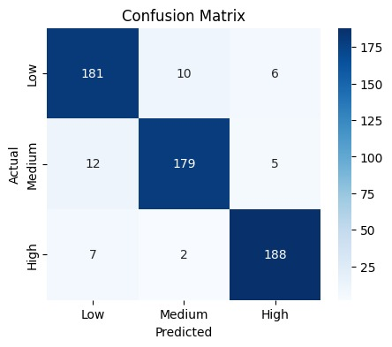
G. Power Prediction Using Random Forest Classifier
Accuracy: 92.88%
Precision: 92.90%
Recall: 92.88%
F1 Score: 92.88%
Key Findings:
Power consumption is classified into Low, Medium, and High categories.
The Random Forest model effectively predicts power consumption with high accuracy.
The confusion matrix shows balanced classification across all categories.
Conclusion:
Random Forest proves to be a reliable model for predicting power consumption based on weather conditions.

Slide 13
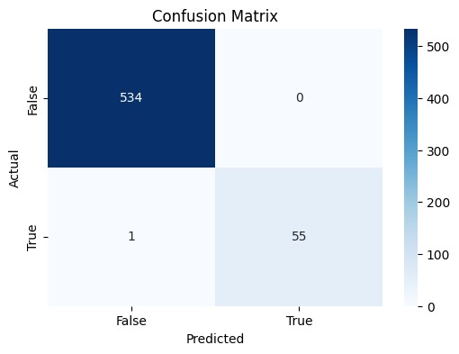
H. Peak Hour Prediction Using CatBoost Classifier
Utilizes the CatBoost Classifier to predict peak electricity usage hours based on weather and power consumption data. The dataset includes features like temperature, humidity, wind speed, and energy usage patterns. The model achieves an impressive accuracy of 99.83%, demonstrating its effectiveness in distinguishing between peak and non-peak hours. Performance evaluation includes a classification report and confusion matrix, confirming high precision and recall for both classes.

Slide 14
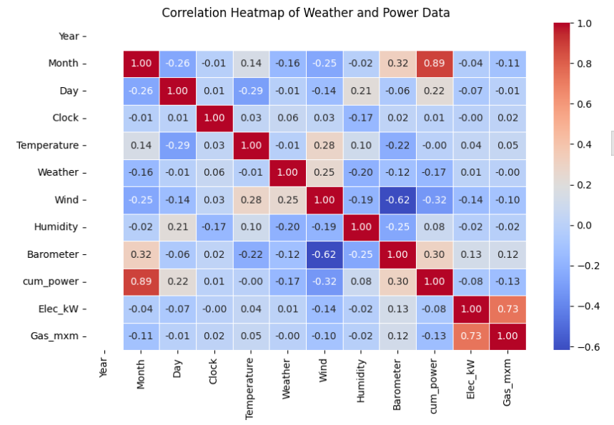
I. Correlation Heatmap of Weather and Power Data
Key Observations from Correlation Analysis:
Elec_kW (Electric Power) and cum_power (Cumulative Power) have a strong correlation, meaning cum_power is influenced by Elec_kW.
Weather parameters (Temperature, Wind, Humidity, Barometer) show varying degrees of correlation with power output.
Humidity and Temperature appear to have some impact on power generation, indicating seasonal/weather dependencies.

Slide 15
J. Electric KW Prediction Using Random Forest (Weka)
Run Information:
Tool Used: Weka
Algorithm: RandomForest with 100 iterations
Dataset: weka_ready_weather_power_data
Total Instances: 2948
Attributes: 12 (Including Year, Month, Day, Clock, Temperature, Weather, Wind, Humidity, Barometer, cum_power, Elec_kW, Gas_mxm)
Train-Test Split: 66% train, 34% test
Model Performance (Test Set):Time Taken to Build Model: 0.78 seconds
Time Taken to Test Model: 0.05 seconds
Correlation Coefficient: 0.7328
Mean Absolute Error (MAE): 5.3851
Root Mean Squared Error (RMSE): 6.7429
Relative Absolute Error: 64.08%
Root Relative Squared Error: 68.52%
Total Instances Tested: 1002
Key Takeaways:
The correlation coefficient of 0.7328 indicates a moderate positive relationship between predictions and actual values.
The mean absolute error (5.3851) and root mean squared error (6.7429) suggest room for improvement in accuracy.
The relative absolute error (64.08%) and root relative squared error (68.52%) indicate that the model has a moderate level of error.
The model was fast to train and test, making it computationally efficient.

Slide 16
K. Power Consumption Prediction (cum_power) Using Random Forest (Weka)
Run Information:
Tool Used: Weka
Algorithm: RandomForest with 100 iterations
Dataset: weka_ready_weather_power_data
Total Instances: 2948
Attributes: 12 (Including Year, Month, Day, Clock, Temperature, Weather, Wind, Humidity, Barometer, cum_power, Elec_kW, Gas_mxm)
Train-Test Split: 66% train, 34% test
Model Performance (Test Set):Time Taken to Build Model: 0.35 seconds
Time Taken to Test Model: 0.03 seconds
Correlation Coefficient: 0.9958 (Indicating a very strong relationship between predictions and actual values)
Mean Absolute Error (MAE): 884.6019
Root Mean Squared Error (RMSE): 1133.7993
Relative Absolute Error: 10.63% (Low error, good accuracy)
Root Relative Squared Error: 11.85% (Indicating high model performance)
Total Instances Tested: 1002
Key Takeaways:
High correlation coefficient (0.9958) suggests excellent prediction accuracy.
Low relative errors (10.63% and 11.85%) indicate the model performed well.
The model was very fast to train (0.35 sec) and test (0.03 sec), making it computationally efficient.
Overall, Random Forest performed exceptionally well in predicting cum_power.

Slide 17
L. Power Consumption Prediction (Elec_kW) Using MLP (Weka)
Run Information:
Tool: Weka
Algorithm: Multi-Layer Perceptron (MLP)
Dataset: weka_ready_weather_power_data
Instances: 2948
Attributes: 12
Train-Test Split: 66% train, 34% test
Model Performance (Test Set):Build Time: 17.13 sec
Test Time: 0.01 sec
Correlation Coefficient: 0.6122 (Moderate correlation)
MAE: 8.1537
RMSE: 10.53
Relative Absolute Error: 97.03%
Root Relative Squared Error: 107.00%
Key Takeaways:
Moderate correlation but high errors indicate poor prediction accuracy.
Long training time (17.13 sec) compared to Random Forest.
MLP struggled with predicting Elec_kW, requiring tuning or better features.

Slide 18
M. Power Consumption Prediction (Elec_kW) Using Linear Regression (Weka)
Run Information:
Tool: Weka
Algorithm: Linear Regression
Dataset: weka_ready_weather_power_data
Instances: 2948
Attributes: 12
Train-Test Split: 66% train, 34% test
Model Performance (Test Set):Build Time: 0.24 sec
Test Time: 0 sec
Correlation Coefficient: 0.729 (Moderate correlation)
MAE: 5.4397
RMSE: 6.737
Relative Absolute Error: 64.73%
Root Relative Squared Error: 68.46%
Key Takeaways:
Faster training & testing compared to MLP and Random Forest.
Moderate prediction accuracy, better than MLP but lower than Random Forest.
Suitable for simple modeling, but may need feature engineering for improvements.

Slide 19
N. Clustering Power Consumption Data Using K-Means (Weka)
Run Information:
Tool: Weka
Algorithm: SimpleKMeans
Dataset: weka_ready_weather_power_data
Instances: 2948
Attributes: 12
Clusters Formed: 2
Iterations: 8
Distance Metric: Euclidean Distance
Cluster Details:
Cluster 0: 48% (1409 instances)
Higher weather index, wind speed, and humidity
Lower barometric pressure and cumulative power consumption
Cluster 1: 52% (1539 instances)
Lower weather index and wind speed
Higher barometric pressure and cumulative power consumption
Performance Metrics:
Within-Cluster Sum of Squared Errors (WCSS): 4076.50
Missing Values: Replaced with mean/mode
Build Time: 0.04 sec
Key Takeaways:
Effective clustering for power usage patterns.
Cluster 0 represents lower power consumption with higher weather impact.
Cluster 1 has higher power usage with lower wind speed & weather variations.
Insights can help optimize energy demand forecasting & consumption strategies.

Slide 20
O. Density-Based Clustering Results (WEKA)
Run Information:
Algorithm: MakeDensityBasedClusterer (SimpleKMeans)
Instances: 2948
Attributes: 12
Clusters Formed: 2
Iterations: 8
Cluster Characteristics:
Cluster 0(Lower Cumulative Power):
Mostly January (1.01), mid-month (15.57), around 12:50. Cooler (~6.07°C) with extreme weather (72.15), stronger winds (16.67 km/h), higher humidity (80.5%), and lower pressure (1020.62). Low power consumption (7440.13), moderate electric usage (4.48 kW), and higher gas consumption (8.72).
Cluster 1 (Higher Cumulative Power):
Mostly February (2.11), around the 13th, at 07:20. Slightly warmer (~6.52°C) with milder weather (55.87), lower wind speeds (12.84 km/h), slightly lower humidity (78.54%), and higher pressure (1028.16). Power consumption is significantly higher (23129.93), with similar electric usage (4.55 kW) and lower gas consumption (8.16).

Slide 21
CONCLUSION:
This project successfully demonstrated the effectiveness of various machine learning and deep learning techniques in predicting and classifying power consumption based on weather data. The results showed that Random Forest and XGBoost were highly effective in regression tasks, while Gradient Boosting and K-Nearest Neighbors performed well in classification. The Multi-Layer Perceptron (MLP) model achieved high accuracy in power consumption classification. Additionally, CNN-based deep learning models provided promising results in forecasting power consumption trends. The integration of clustering techniques, such as K-Means and density-based clustering, helped analyze consumption patterns. The findings from this project can contribute to optimizing power usage, improving grid efficiency, and developing energy management strategies for sustainable power consumption.

Slide 22
FUTURE SCOPE:
Advanced AI Models – Implementing Transformer-based models and hybrid AI approaches for more accurate forecasting.
Real-Time Data Integration – Using IoT sensors and satellite data to improve real-time weather and power predictions.
Smart Grid & Energy Storage – Enhancing demand forecasting, energy storage optimization, and smart grid integration.
Cloud & Edge Computing – Deploying scalable AI solutions for real-time power forecasting and grid management.
Explainable AI & Security – Improving model transparency, regulatory compliance, and cybersecurity in power prediction systems.

Slide 23
REFERENCE:
[1] L. Breiman, “Random forests,” Machine Learning, vol. 45, no. 1, pp. 5–32, 2001.
[2] T. Chen and C. Guestrin, “XGBoost: A scalable tree boosting system,” in Proc. 22nd ACM SIGKDD Int. Conf. Knowl. Discov. Data Min. (KDD), San Francisco, CA, USA, Aug. 2016, pp. 785–794.
[3] Y. LeCun, Y. Bengio, and G. Hinton, “Deep learning,” Nature, vol. 521, no. 7553, pp. 436–444, May 2015.
[4] I. Goodfellow, Y. Bengio, and A. Courville, Deep Learning. Cambridge, MA, USA: MIT Press, 2016.
[5] J. Bergstra and Y. Bengio, “Random search for hyper-parameter optimization,” J. Mach. Learn. Res., vol. 13, no. 1, pp. 281–305, Feb. 2012.
[6] A. Krizhevsky, I. Sutskever, and G. E. Hinton, “ImageNet classification with deep convolutional neural networks,” in Proc. Adv. Neural Inf. Process. Syst. (NIPS), 2012, pp. 1097–1105.
[7] J. Friedman, T. Hastie, and R. Tibshirani, “Additive logistic regression: A statistical view of boosting,” Ann. Stat., vol. 28, no. 2, pp. 337–407, Apr. 2000.
[8] L. Rokach and O. Maimon, “Clustering methods,” in Data Mining and Knowledge Discovery Handbook. Boston, MA, USA: Springer, 2005, pp. 321–352.
[9] J. MacQueen, “Some methods for classification and analysis of multivariate observations,” in Proc. 5th Berkeley Symp. Math. Statist. Probab., vol. 1, 1967, pp. 281–297.
[10] P. J. Werbos, “Backpropagation through time: What it does and how to do it,” Proc. IEEE, vol. 78, no. 10, pp. 1550–1560, Oct. 1990.

Slide 24
THANK YOU

